Slide 1
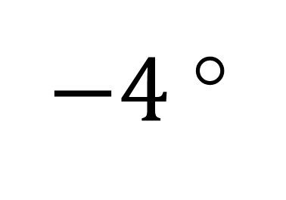
$−4$°
t = 280 s

